Slide 1

CS2009 Design and Analysis of Algorithms
Binary Search Algorithm

Slide 2
Binary Search Algorithm
Given a sorted array of integers and a target value, find out if target exists in the array or not
Input: arr[] = {3,4,6,7}, target = 4
Output: Target is in index 2 (if index starts from 1)
Trivial/Simple Solution: Simple solution is “Linear Search” which will check every element of array to find the required element and hence O(n) complexity. But “Binary search algorithm” does it in Log(n) time by recursively breaking it.
Binary search precondition is array should be sorted

Slide 3
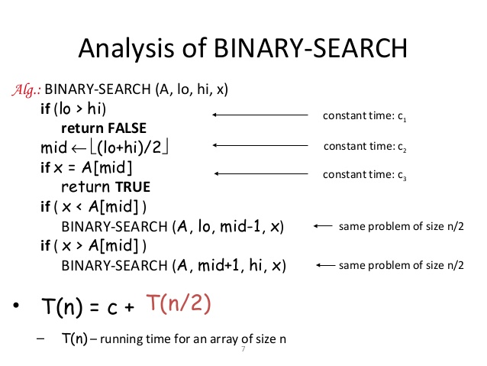
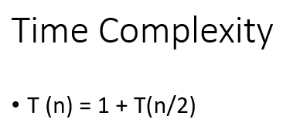

Binary Search Algorithm
Sometimes considered as divide
and conquer algorithm
Best case time would be O(1) when
element to be found is present in middle

Slide 4
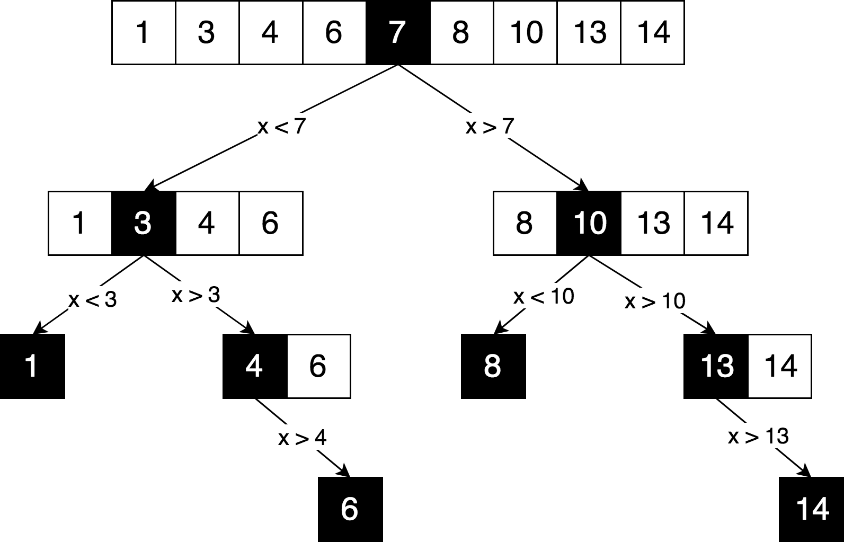
Binary Search Algorithm

Slide 5
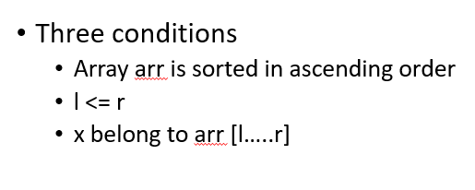
Binary Search Algorithm
Loop invariant of Binary Search :
Here l = lo = index of left most element
Here r= hi = index of right most element

Slide 6
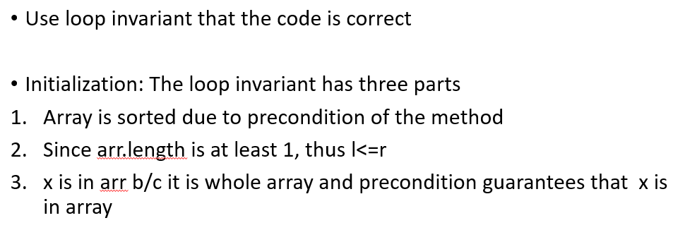
Binary Search Algorithm

Slide 7
Binary Search Algorithm
Maintenance :
1. Array order is never changed so first point holds. It is sorted.
2 & 3. Think it yourself. Try to convince that there could be three possibilities. Number belongs to mid element index or in the left part or in the right part. But where ever it is, l<=r will hold. And number will belong to any of the three parts which means that x belongs to array[l….r]

Slide 8
Binary Search Algorithm
Termination :
Think it yourself. Assuming the loop invariant holds at the start of each iteration, show that some quantity (index) strictly decreases, and that it cannot decrease indefinitely without making the loop invariant false.

